Slide 1
T-Mobile
Social Media Marketing Plan
Notes:
I’m Dawn Harper with Brandman University, and this is the new T-Mobile social media marketing plan!

Slide 2
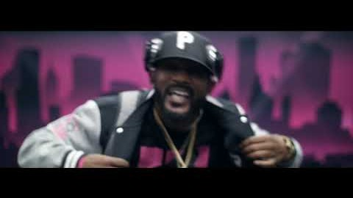
Pessi, B. (2018) T-Mobile Song "Let Me Clear My Throat "Remix. YouTube.com. Retrieved from: https://youtu.be/d42vrw2v9w8
Notes:
At T-Mobile we are all about fun for our employees and customers! This video stars and was created all by T-Mobile employees. You can see at our core we invest in our internal community just as much as our external community. We want to keep this energy going!

Slide 3
Our primary goal is improving our already solid track record of:
Customer’s First!
Social media customer service focus
Customer engagement with brand
Notes:
Our core social media marketing plan is to keep what we are doing well such as Facebook customer service, but increase the availability of the service on multiple platforms. Ensure our customers know the option is available by letting everyone know…no hold times and phenomenal service! Our second goal is to get customers more engaged with T-Mobile brand, securing a trust, and creating a fun environment.

Slide 4
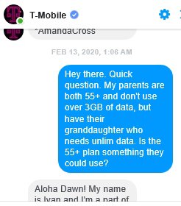
Harper, D. (2020). Real-time T-Mobile customer service interaction via Facebooks “send message” option. Retrieved from: https://www.facebook.com/TMobile/.
Notes:
This was my personal experience with using T-Mobile Facebook customer service. This. This is everything. It is personal, cheerful, and informative. I did not have to wait on hold at all, let alone an hour to get assistance. My question was answered, and I feel the experience was helpful for my parents as well, increasing my loyalty and potentially theirs. We need more of this!

Slide 5
Utilizing social media platforms in innovative ways
TikTok
Instagram
Pandora
Notes:
TikTok – Fun, attention grabbing music, short and exciting
YouTube – Create new content that gets customers engaged, getting them to want to respond to the ad campaign
Pandora – Create Podcasts that are interesting, educational, fun by having current popular celebrity hosts.
Our social media platforms will evolve as our customers do, so when another new platform comes out, if it is a fit we will utilize it too. We want to be where our customers are!

Slide 6
Not to worry
Facebook
Twitter
YouTube
Are not going anywhere.
Notes:
Our customers will absolutely still have access to our older platform cites like Facebook, Twitter, and YouTube, they will just get to feel the love more. Faster access to customer care when they select the “send message” option, if they comment on any of our social media platforms our customers will have a faster resolution or response. We are innovating our advertising to intentionally drive customers to social media so they can participate in games, or engage with our commercials by responding and getting responses. We want to be everywhere, but not intrusive, like a reliable best friend.

Slide 7

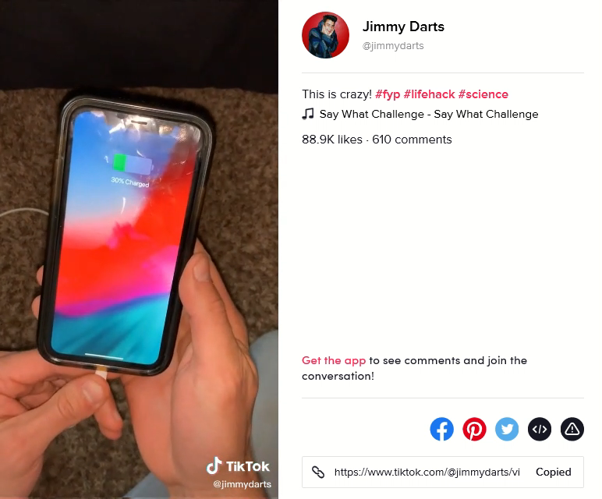
Darts, J. (2020) Tiktok. Retrieved from: https://www.tiktok.com/@jimmydarts/video/6795679691240901894 and audio file Parov Stelar “Booty Swing” 2012. Retrieved from: https://www.youtube.com/watch?v=Eco4z98nIQY
Notes:
With TikTok, this example is not be factually accurate (you can charge with fruit but it takes more science than this simplified video is showing per Kenzi Mudge on Quora.com) it is still fun and thought provoking which is exactly what we want.

Slide 8
Our energy will be focused in multiple areas all leading to CUSTOMER SATISTFACTION and customer loyalty.
Merger with Sprint
Low Costs
5G network is here!
Internet of Things
New 5G capable products
ENGAGE Our customers
Notes:
Our energy will be focused in multiple areas all leading to CUSTOMER satisfaction and customer loyalty.
Merger with Sprint will increase our market value and ensure we become a larger competitor, coverage will be broader and deeper keeping our customers connected, at faster speeds. With more customers also comes with the opportunity to keep our costs low. Roll out and expand 5G network, as mentioned in the packet by 2024 we intend to be at 70% 5G coverage over the US. With 5G comes exciting new 5G products and new capabilities that will work with Internet of Things and more. Ultimately we want to ENGAGE Our customers. When our customers feel that we hear them, we have better and faster coverage so they can depend on us, all leads to customers who trust us with their business and will be satisfied loyal customers.

Slide 9
It’s simple really…
Budget is a healthy 500 Million.
T-Mobile ahead in the customer service industry.
New content development in mind
Customers and employees engaged and having fun!
Notes:
Tmobile’s social media budget is a healthy 500 Million as we know putting our customers first is an overall company investment. We believe a focus on social media customer service will bring T-Mobile ahead in the customer service industry. The budget is set with new content development in mind, ultimately we want our customers, and employees engaged and having fun!

Slide 10
References
Harper, D. (2020). Real-time T-Mobile customer service interaction via Facebooks “send message” option. Retrieved from: https://www.facebook.com/TMobile/.
Mudge, K. (2017). Can an orange charge an iphone? Quora.com. Retrieved from: https://www.quora.com/Can-an-orange-charge-a-phone
Pessi, B. (2018) T-Mobile Song "Let Me Clear My Throat "Remix. YouTube.com. Retrieved from: https://youtu.be/d42vrw2v9w8
Video 2: Darts, J. (2020). Life hack. TikTok. Retrieved from: https://www.tiktok.com/@jimmydarts/video/6795679691240901894
Video 2: Parov Stelar “Booty Swing” 2012. Retrieved from: https://www.youtube.com/watch?v=Eco4z98nIQY

